Slide 1

Stata Workshop 2: Intermediate
FHSS Research Support Center

Slide 2
FHSS Research Support Center
What does the Research Support Center do?
Help you with their research projects (students, grad students, faculty)
Provide statistical support
Troubleshoot statistical software
Help you to use Stata, SPSS, Mplus, AMOS

Slide 3
Topics Today
Recap of Workshop 1
Commands
  Merging
  Duplicates/missing data
  Reshaping data
  Macros
  Loops
Questions

Slide 4
Recap
Workshop 1
Setting up Stata
Data import
Renaming, labeling
Recoding
Notes:
- I have handouts
- this information will be posted to our website too, so don’t worry!

Slide 5
Topics Today
Recap of Workshop 1
Commands
  Merging
  Duplicates/missing data
  Reshaping data
  Macros
  Loops
Questions

Slide 6
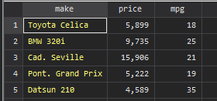
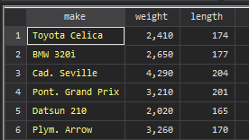
Merge Example
Example: car make, details
Adding variables to a set of common observations
+
= ?

Slide 7

Merge Example
Example: car make, details
Adding variables to a set of common observations
+
= ?

Slide 8
Merge Example
Example: car make, details
Adding variables to a set of common observations
+
= ?

Slide 9
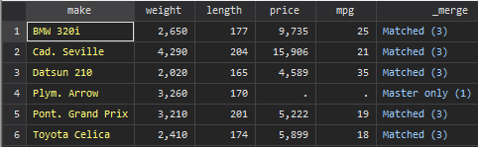

Merge Example
Example: car make, details
Adding variables to a set of common observations
+
=
We are merging “on” the common/key variable
Command: merge 1:1 <variable> using <file>
Notes:
- Try to replicate this!
- Recommend: run a command, then open the data editor (via edit in command line)

Slide 10
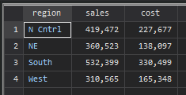
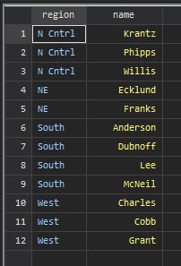
Another Merge Example
Example: regional sales
Command: help merge
Merging by observation number instead of a key variable
= ?
+

Slide 11
Another Merge Example
Example: regional sales
Command: help merge
Merging by observation number instead of a key variable
= ?
+

Slide 12
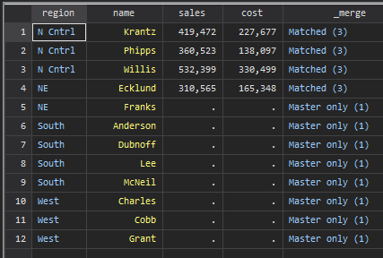
Another Merge Example
Example: regional sales
Command: help merge
Merging by observation number instead of a key variable
=
+
Notes:
Data is supplemented by observation

Slide 13
Another Merge Example
Example: regional sales
Command: help merge
Merging by observation number instead of a key variable
For a common variable in both datasets, the data from the currently open dataset was kept.
Other variables were added by position.
=
+

Slide 14
Duplicates
Example: test scores
  Command: sysuse duplicates, clear

Slide 15
Duplicates
Example: test scores
To examine duplicates:
Command: duplicates report
Tells us how many observations are identical across all variables
Surplus column tells us how many extra observations exist

Slide 16
Duplicates
Example: test scores
To list duplicates as entire observation:
Command: duplicates list, sepby(id)
Blue text is optional - we can visually sort by a variable if we want

Slide 17
Duplicates
Example: test scores
What to do with the duplicates?
Command: duplicates drop
  Command: duplicates report (now we have 0 duplicates)

Slide 18
Duplicates
Example: test scores
What if we don’t have an exact duplicate?
  Visual inspection (edit) & tabulation (tab id)
Command: replace math = 84 if id ==1
      You need to verify the true values to do this

Slide 19
Missing
Example: test scores
Command: ssc install missings
Command: missings report
Missings are coded with a period
  If importing from another program, replace <variable> = . if <variable> == -999

Slide 20
Missing
Example: test scores
Command: missings dropvars, force
Command: missings dropobs, force
Missings are coded with a period
  If importing from another program, replace <variable> = . if <variable> == -999

Slide 21
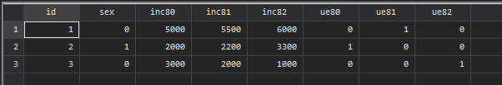
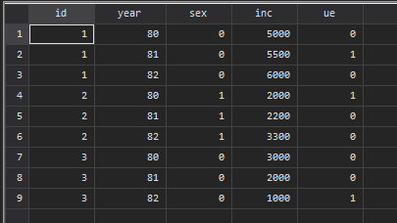
Reshaping
Example: income collected each year
Wide Format: a subject’s repeated responses will be in a single row.
1 observation per row
Long Data
Long Format: every variable collected will be in a column.
  Multiple observations at each year

Slide 22

Reshaping
Example: income collected each year
Wide Format: a subject’s repeated responses will be in a single row.
1 observation per row
Long Data
Long Format: every variable collected will be in a column.
  Multiple observations at each year

Slide 23

Reshaping
Example: income collected each year
Wide Format: a subject’s repeated responses will be in a single row.
1 observation per row
Long Data
Long Format: every variable collected will be in its own column.
  Multiple observations at each year

Slide 24

Reshaping
Example: income collected each year
Command: webuse reshape1, clear
Long Data
Command: reshape long inc ue, i(id) j(year)

Slide 25
Loops
Example: tabulate and sum every variable
Example 1: Foreach Variable Loop
For each variable in this list x, y, z
Do tasks a, b

Slide 26
Loops
Example: tabulate and sum every variable
Example: Forvalues Loop
For values in this range, i , between 0 and n
Do tasks a, b

Slide 27
Macros
Example: global vs. local macro
Macro: a shortcut for a string
Global: shortcut saved permanently
Local: shortcut saved temporarily, usually within a loop

Slide 28
Macros
Example: global vs. local macro
Example: local macro
local number = 123
display `number'
Notes:
We use quotes to specify a string macro. Assigning a number to a macro doesn’t require quotes.

Slide 29
Macros
Example: global vs. local macro
Example: local macro
local variables = "inc80 ue80 inc81 ue81 inc82 ue82"
display “ `variables’ "
Notes:
Notice that in your do-file/command line, the local macro without quotes around 123 is different color than the numString
We use quotes to specify a string macro. Assigning a number to a macro doesn’t require quotes.

Slide 30
Variable Lists (global macro)
Example: variable list
vl create VariableListName = (var1 var2 var3…)

Slide 31
Application: Macro and Loop to Label
Example: Let’s say that we wanted to label our unemployment variables.
- Use a variable list to hold the unemployment variables.
- Create a Foreach Variable loop
- label each variable with a reminder “unemployment + year”

Slide 32
Questions?

